Slide 1

Sorting Spartans DSA Review -2
Multi-Level Skip List
S.No | Name | Roll No
1. | Hari Kesav.D | CB.EN.U4CSE21421
2. | M.K.Eniyan | CB.EN.U4CSE21435
3. | Mitesh | CB.EN.U4CSE214
4. | Raj Kumar | CB.EN.U4CSE214
5. | Harecharan | CB.EN.U4CSE21450

Slide 2
What is Hybrid Data Structure?
A hybrid data structure combines one or more features of other data structures in order to better implement the implementation of data storage.
It frequently employs the advantages of each component structure to effectively handle certain issue needs.
This combines many data structures to offer the best speed, memory efficiency, and usefulness for a particular application or problem domain.

Slide 3
Overview of the Hybrid Data Structure:
Skip List – Overview
Finding a given entry in a traditional singly-linked list of sorted integers requires scanning the entire list, which results in a linear search with an O(n) time complexity. Contrary to arrays, we cannot rapidly enter the middle of the list to conduct a binary search.
An alternative is to use a skip list to get around this restriction. A skip list is a data structure made up of several linked lists, each of which has roughly half the nodes of the one before it. Faster searching is possible thanks to its hierarchical structure.
A multi level skip list is just a skip list with multiple levels, decreasing in amount of elements.

Slide 4
Let us look at some functions that we have implemented in multi level skip list
INSERTION:
The changes in a skip list are made by altering the chains at each level after the desired location for insertion or deletion is identified.
To insert an element, a new node is created and inserted into the appropriate positions within each level. For erasing an element, the corresponding nodes are unlinked and removed from each level.
The desired element is located using the search() method by starting from the head node and traversing through the levels. It begins at the top level and compares the elements in that level. If the desired element is greater than the current element at the top level, the pointer moves down to the next layer. This process continues until the element is found.

Slide 5
Multilevel skip list ( CREATION )
HEADER
NULL
9
9
9
9
4
4
4
6
6
6
8
8
8
2
2
5
5
10
10
1
3
7

Slide 6
Multilevel skip list ( SEARCHING )
SEARCH Node 3
HEADER
NULL
9
9
9
9
4
4
4
6
6
6
8
8
8
2
2
5
5
10
10
1
3
7

Slide 7
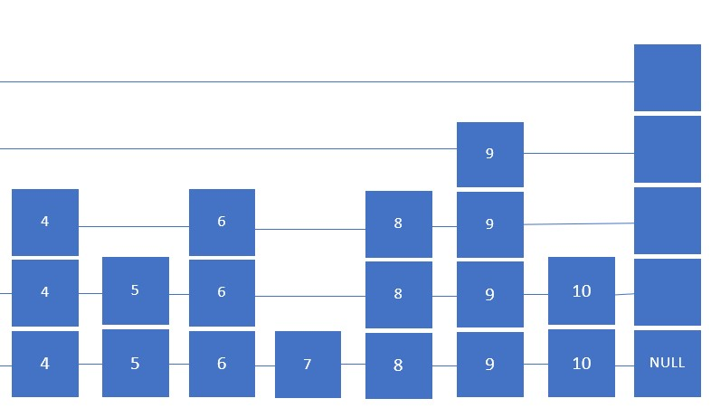
Multilevel skip list ( INSERTION )
INSERT Node 3.5
HEADER
2
2
1
3

Slide 8
Multilevel skip list ( INSERTION )
INSERT Node 3.5
HEADER
3.5
3.5
3.5
3.5
3.5
2
2
1
3

Slide 9
Multilevel skip list ( INSERTION )
INSERT Node 3.5
HEADER
3.5
3.5
3.5
3.5
3.5
2
2
1
3

Slide 10
Multilevel skip list ( DELELTION )
DELETE Node 3.5
HEADER
3.5
3.5
3.5
3.5
3.5
2
2
1
3

Slide 11
Multilevel skip list ( DELETION )
DELETE Node 3.5
HEADER
2
2
1
3

Slide 12
TIME COMPLEXITY
Skip lists offer efficient time complexity for find, insert, and erase operations. On average, searching for an element (find operation) takes O(log n) time by traversing through the skip list levels. Similarly, insertion and deletion (insert and erase operations) also take O(log n) time on average. This is because they involve locating the correct position and modifying the chains at each level. The logarithmic time complexity of skip lists makes these operations significantly faster than linear search in a singly-linked list.

Slide 13
SPACE COMPLEXITY
The space complexity of a multilevel skip list is O(n), where n is the number of elements stored in the skip list. This space complexity arises from the storage required for the nodes in the skip list. Each node contains the value of an element and a set of forward pointers, which allow for efficient traversal of the skip list levels. The number of levels in a skip list is typically logarithmic to the number of elements, resulting in a space complexity proportional to the number of elements stored. Additionally, any additional metadata or auxiliary data structures used to support the skip list may contribute to the overall space complexity.

Slide 14
Multilevel skip list (TREE)
HEADER
3.5
2
1
3

Slide 15
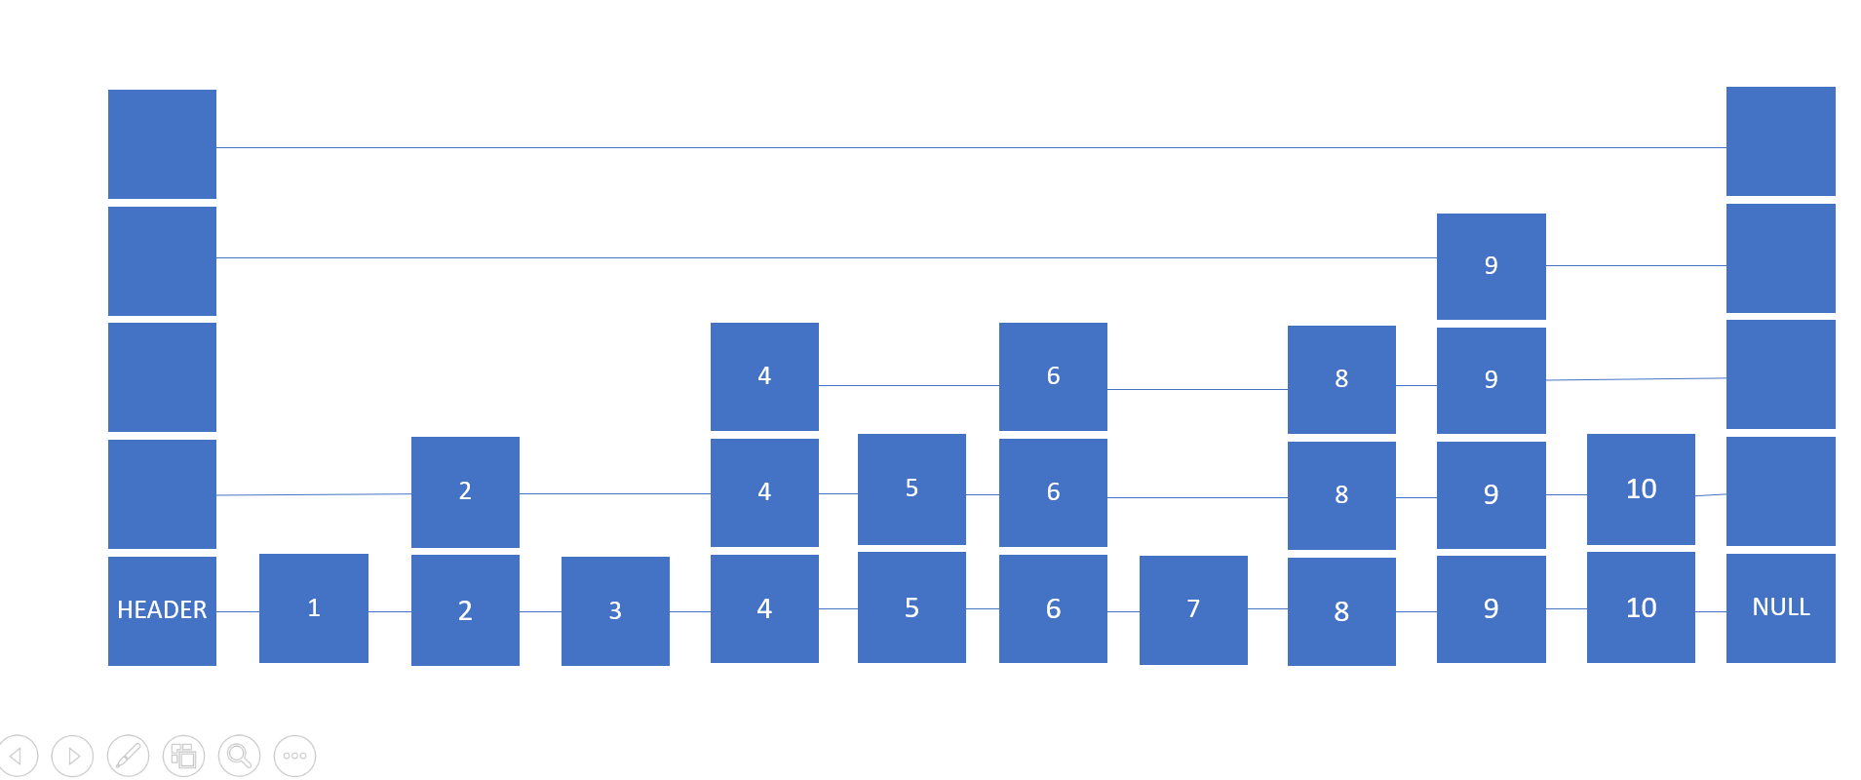
Multilevel skip list ( TREE )
SKIP LIST 1
SKIP LIST 2
SKIP LIST 3

Slide 16
Time complexity of bst multilevel skiplist
The time complexity of the hybrid data structure will depend on the specific operations you perform.
Search:
For values within the ranges covered by the BST nodes, the search operation can be performed in O(log n) time, where n is the number of elements in the BST. This is the same time complexity as a regular BST search.
For values outside the ranges covered by the BST nodes, you would need to perform a search operation in the multilevel skip list. In a standard multilevel skip list, the average time complexity for search is O(log n), where n is the number of elements stored in the skip list.

Slide 17
Cont…
Insert:
If the value falls within the ranges covered by the BST nodes, the insert operation can be performed in O(log n) time, where n is the number of elements in the BST. This is the same time complexity as a regular BST insertion.
If the value falls outside the ranges covered by the BST nodes, you would need to perform an insert operation in the multilevel skip list. In a standard multilevel skip list, the average time complexity for insert is O(log n), where n is the number of elements stored in the skip list.

Slide 18
Erase:
The erase operation for values within the ranges covered by the BST nodes can be performed in O(log n) time, where n is the number of elements in the BST. This is the same time complexity as a regular BST deletion.
For values outside the ranges covered by the BST nodes, you would need to perform an erase operation in the multilevel skip list. In a standard multilevel skip list, the average time complexity for erase is O(log n), where n is the number of elements stored in the skip list.

Slide 19
Cont..
Overall, the hybrid data structure provides similar time complexities to a regular multilevel skip list and a regular BST for operations within their respective ranges. The advantage of the hybrid structure is that it allows for efficient skipping over large sections of elements that are outside the BST node ranges. This can be particularly advantageous when the number of elements skipped is significantly larger than the number of elements covered by the BST nodes. It helps reduce the overall number of comparisons and traversals required, leading to potentially faster search and insertion times compared to a regular multilevel skip list in certain scenarios.

Slide 20
Implementation
The search() function starts from the top layer and compares values with the user-provided value. If the value is found, True is returned; otherwise, the search continues to the next layer until the value is found or the end of the Skip List is reached, in which case False is returned.
The delete() function begins from the top layer and compares the current value with the value provided for deletion. If the current value is greater, the next layer is checked. If a match is found, the connection between the elements is removed.
The display() function is used to show the elements of the Skip List across each layer.
A menu-driven program allows the user to perform operations on the Skip List, such as inserting, deleting, or searching for values. The Skip List is then inserted into a binary tree data structure to create the hybrid data structure. This process continues until the desired results are achieved by the user.

Slide 21
Practical application
Multi-level skip lists are used in database systems for efficient indexing and querying of large datasets.
They are suitable for indexing spatial data, enabling faster range searches and nearest neighbor queries.
Geographic information systems (GIS) benefit from multi-level skip lists for organizing and retrieving spatial data.
Web search engines utilize multi-level skip lists to enhance search result retrieval speed.
File systems can improve file retrieval and searching activities by incorporating multi-level skip lists.
Cache data structures can optimize data access and retrieval by integrating multi-level skip lists.

Slide 22
Practical application …
Network routing algorithms can be more effective by utilizing multi-level skip lists for faster routing decisions.
Incorporating a skip list within a binary tree data structure combines their strengths for improved performance.
The combination enables effective search, insertion, and deletion operations with balanced design.
Skip lists provide adaptability to shifting data access patterns, complementing the static structure of trees.
The hybrid structure offers memory efficiency by reducing the memory burden of skip lists.
Concurrent operations can be supported effectively by combining skip lists and tree structures.

